Slide 1
Lesson 1 - Intro

Slide 2


Who we are?
Yarik (SPD-Ukraine)
Vasya (SPD-Ukraine)

Slide 3
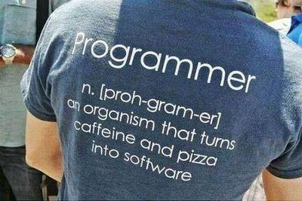
Lesson goals
Greetings
Expectations
Existing Knowledge
Last Year experience
Course Goals
Course Rules
Homework

Slide 4
Greetings, Expectations, Knowledge
Your name
Small info about yourself(education, work, etc)
Your expectations from course
How prepared to course (completed courses, books about Java etc)
Current knowledge of Java or any other language

Slide 5
Last years experience
4 years on GeekHub J4W course
Last year 15 students
Last year 5 students got GeekHub certificate
Many of students got a job as a Junior Java developers in different companies in Cherkasy
P.S. Asking questions is a good way to learn more

Slide 6
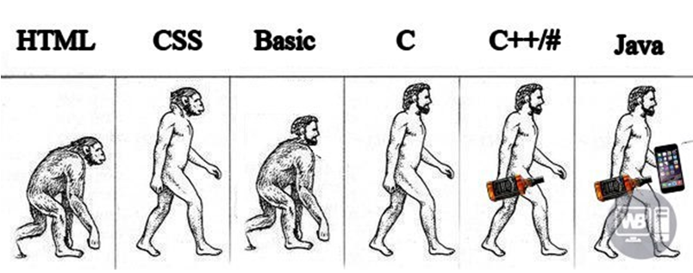
Course goals
Read
Understand
Create
Update

Slide 7
Course action plan
Core
Basics
OOP
Code testing
Exceptions
Collections, Generics
Functional Programming
IO
Concurrency
Database
Web
Servlet API
REST
Spring Framework (MVC, Boot, JDBC, Security)
…

Slide 8
Course activities
Lectures
Practices
Homeworks
Course work

Slide 9
Homework type ?
Every homework task will be dedicated only to specific topic and code will not be related on previous homeworks
Every homework task related to each other and as a final result we will get an fully functional project

Slide 10
IDE
Intellij IDEA by JetBrains

Slide 11
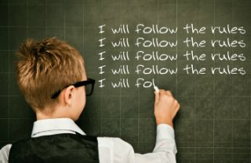
Code convention: Read. Remember. Follow.
Java Code Convention by Google

Slide 12

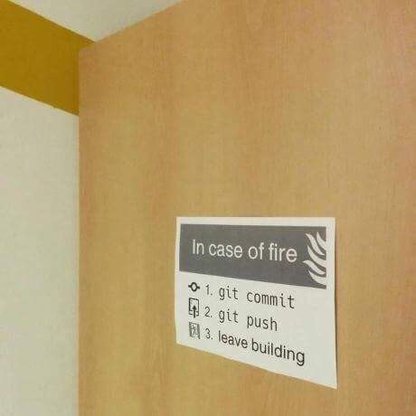
Version Control System (VCS)

Slide 13

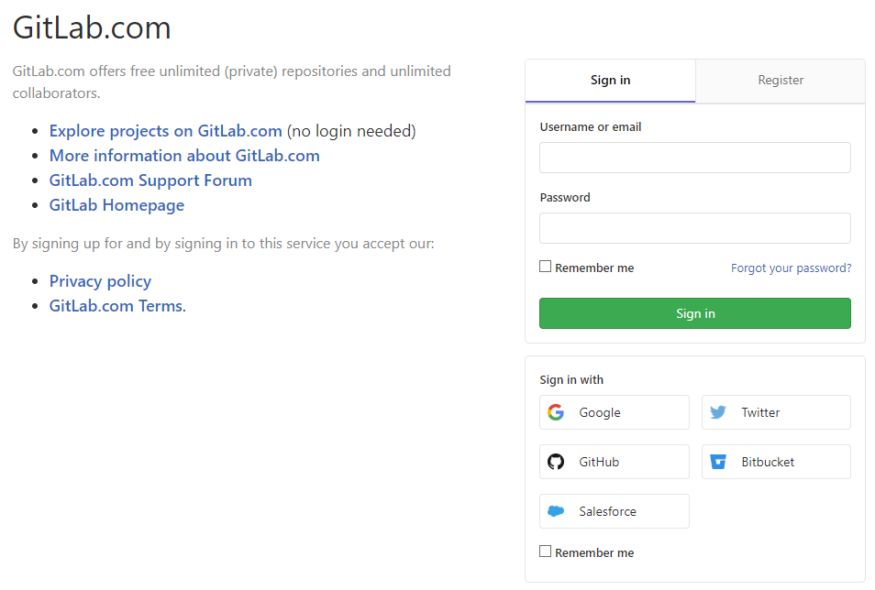
Cloud repository

Slide 14
Homework Quality Control
GitLab issues
Code Review
Fixes after Code Review
Homework Common Issues Review

Slide 15
Homework Quality Rules
Code is formatted
Code is organized
Code is verified by CheckStyle

Slide 16
Homework Quality Rules
Commit message pattren: L## descriptable message
Example:
L01 Added readme file
L12 Fixed code formatting
Issue title pattern: L## Homework Review
Example:
L01 Homework Review
L12 Homework Review

Slide 17
Good coding practices
Best practice - is a technique or methodology that, through experience and research, has proven to reliably lead to a desired result.

Slide 18
Good coding practices
Best practice - is a technique or methodology that, through experience and research, has proven to reliably lead to a desired result.
Java Code Convention: By Google
Clean code principles
40 Tips that will change your coding skills forever
Developers jargon
Books:
“Clean Code” by Robert Martin
“Java: The Complete Reference” by Herbert Schildt

Slide 19
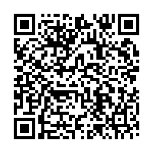
Homework
Download, install and setup required software
Create GitLab account
Fork course repository
Configure checkstyle plugin for IDEA
Add support of “.gitignore” in project
Make a first commit/push
(optional) Take a screenshot of homework result
Create a Gitlab Issue with attached screenshot and assign to a lector

Slide 20
Quality is more important than amount

Slide 21
Thanks!
Questions?
Find us in Slack:
@Yaroslav Brahinets
@Vasya Rudas

